Slide 1
Categorical Data Analysis on the Factors that Affect Employee Turnover in a Company
JIN Xi 1530005013
TIAN Wei 1530005029
WANG Mengmeng 1530005030
WEI Guizhi 1530005031
XIE Weiyan 1530005037
ZHANG Jianyi 1530005049

Slide 2
CONTENTS
PRAT ONE
Motivation & Data Preparation and Description
PART TWO
Logistic Regression
PART THREE
Conclusion & Discussion

Slide 3
PART ONE
Motivation & Data Preparation and Description

Slide 4
Our example concerns a big company that wants to understand why some of their best and most experienced employees are leaving prematurely
Motivation
Two goals:
Understand why valuable employees leave
Predict who will leave next

Slide 5

Satisfaction_level (continuous:[0,1])
Last_evaluation (the time since the satisfaction evaluations)
Monthly_working_hours
Number_projects (how many be done)
Exp_in_company (working time (unit: yr ))
Data Description
Work_accident (0,1)
Promotion_last_5years (0,1)
Role (which department they are in)
Salary (the relative levels of the salary)
Left (0,1)
For the categorical variables, we transform them into factors before building the regression model

Slide 6
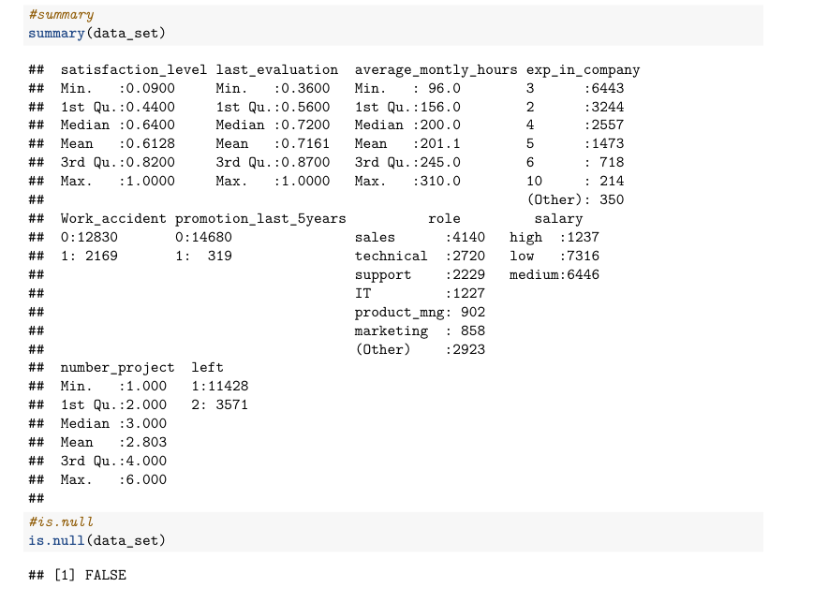
Summary of the dataset

Slide 7
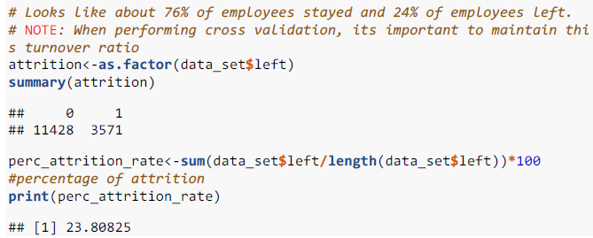
Statistical overview
The distribution of the data is imbalance: the majority of employees(over 75%) stayed while only a small part of them left

Slide 8
Turnover V.S. Satisfaction
Data visualization
Tri-modal distribution for employees who left:
Employees who had really low satisfaction levels (0.2 or less) , who had low satisfaction levels (0.3~0.5) and had really high satisfaction levels (0.7 or more) left the company more

Slide 9
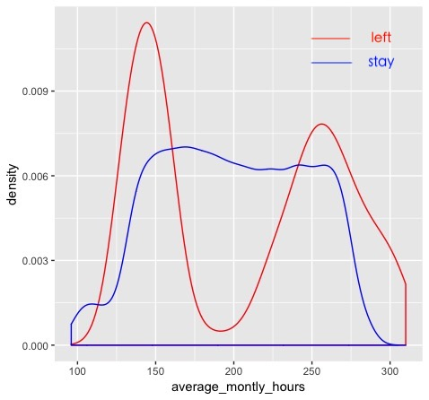
Turnover V.S. Average Monthly Hours
Data visualization
Bi-modal distribution for employees who left:
Employees who left generally were underworked or overworked

Slide 10
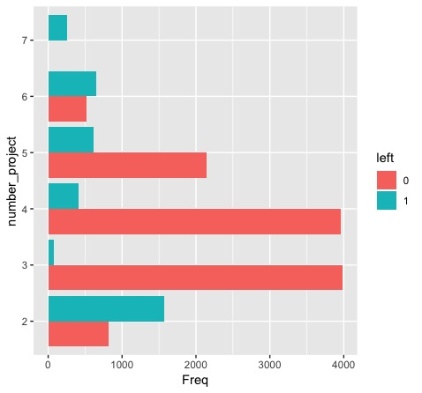
Turnover V.S. Project Count
Data visualization
More than half of the employees with 2,6, and 7 projects left the company
Majority of the employees who did not leave the company had 3,4, and 5 projects All of the employees with 7 projects left the company
There is an increase in employee turnover rate as project count increases

Slide 11
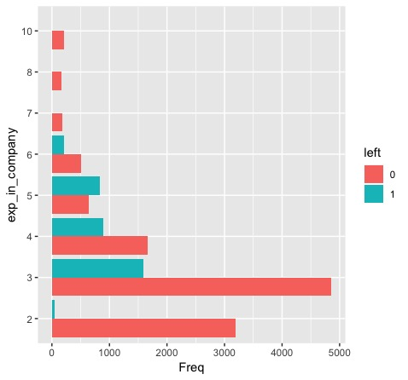
Turnover V.S. Experience in company( unit: yr)
Data visualization
The employees who have spent 3~5 years in the company are more likely to leave the company.

Slide 12
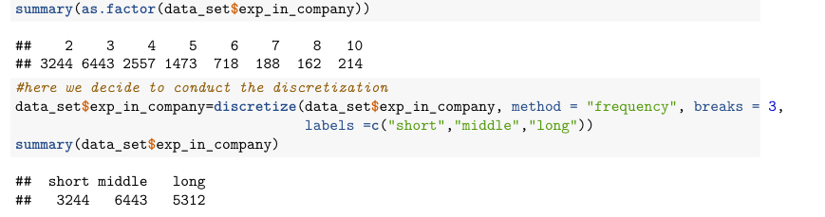
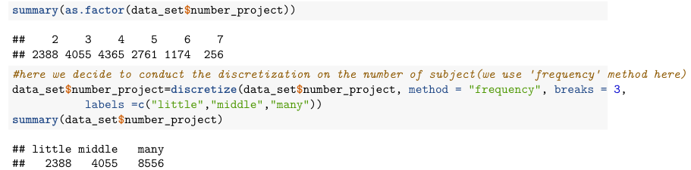
Discretization on Project Count and Experience in company

Slide 13
PART TWO
Logistic Regression

Slide 14
Model

Slide 15
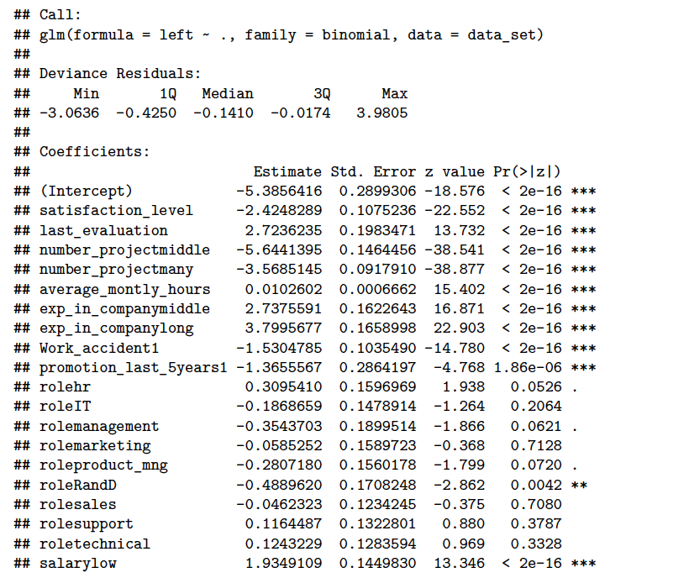
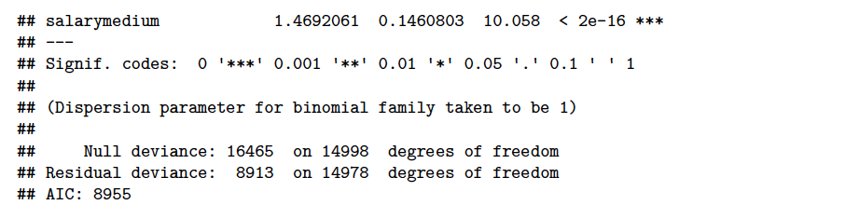
Full model(without interaction)
AIC=8955

Slide 16
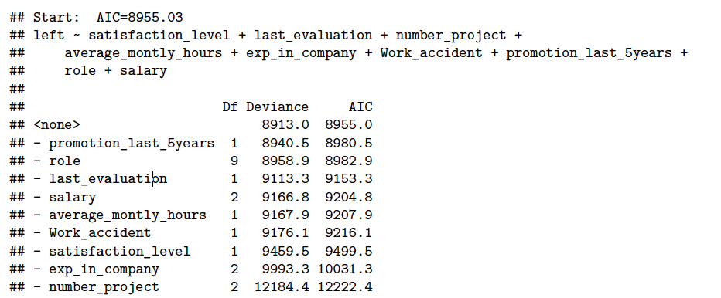
Simpler model
Backward：

Slide 17
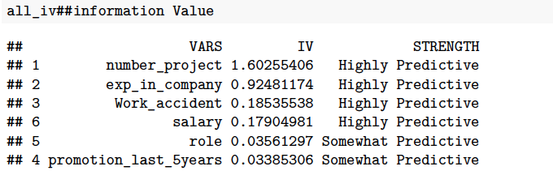
Information Value
Definition(IV):
a measure of the predictive capability of a categorical x variable to accurately predict the goods and bads

Slide 18
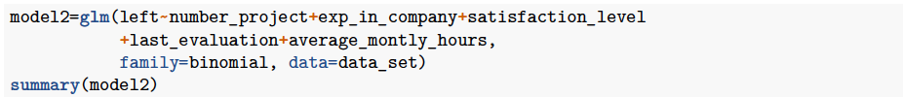
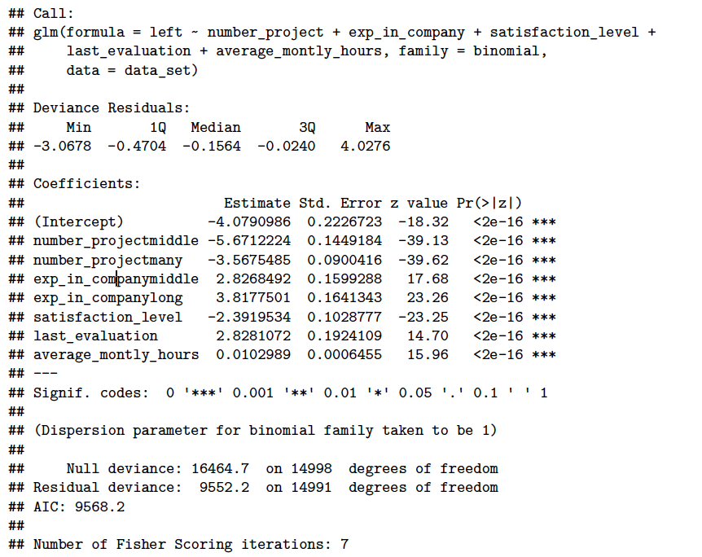
Model with first 2 IV Variables (without interaction)
AIC=9568.2 > 8955

Slide 19
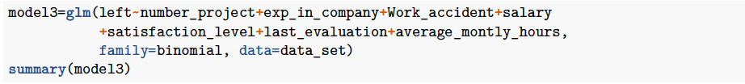
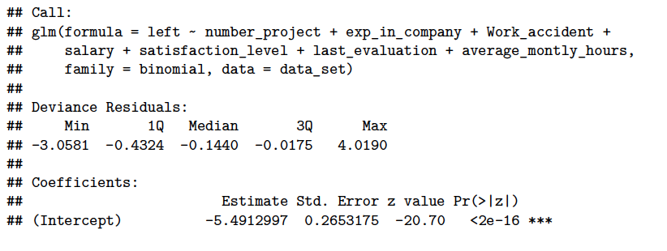
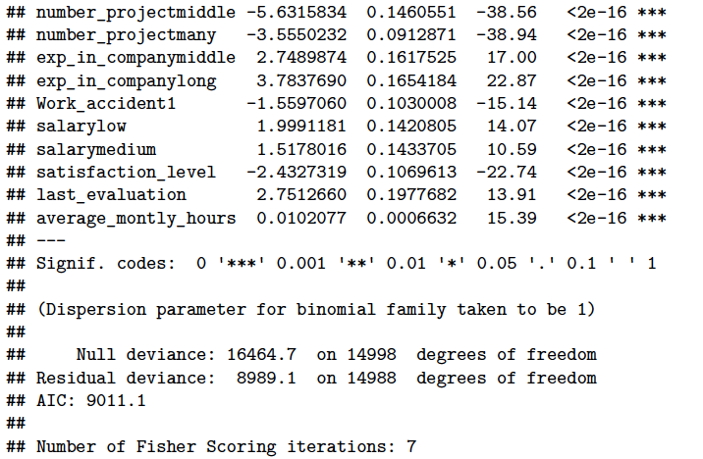
Model with first 4 IV Variables (without interaction)
AIC=9011.1 > 8955

Slide 20
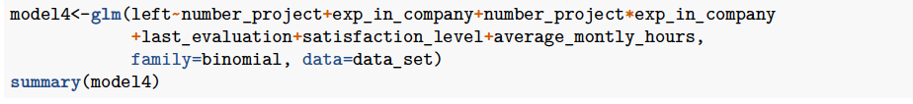
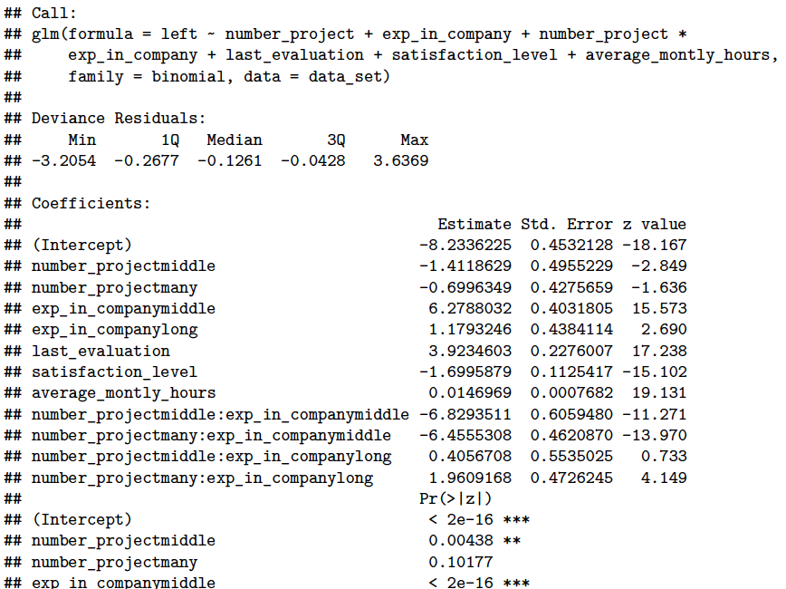
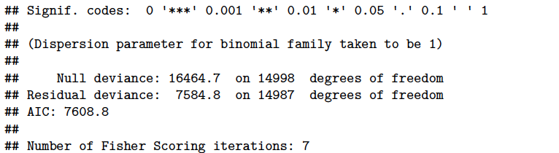
Model with first 2 IV Variables (with interaction)
AIC= 7608.8 < 8955

Slide 21
Model Evaluation

Slide 22
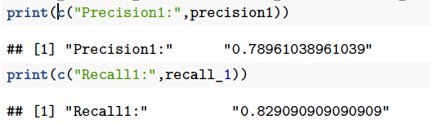
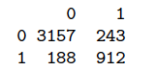
Model without resampling data
Confusion Matrix

Slide 23
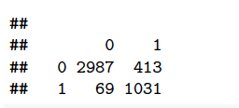
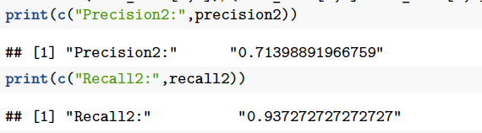
Model with resampling data
Confusion Matrix

Slide 24
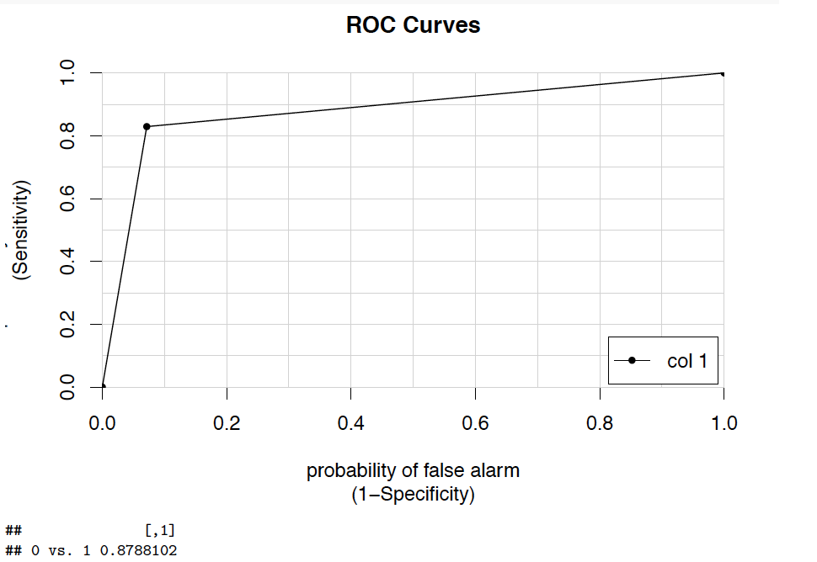
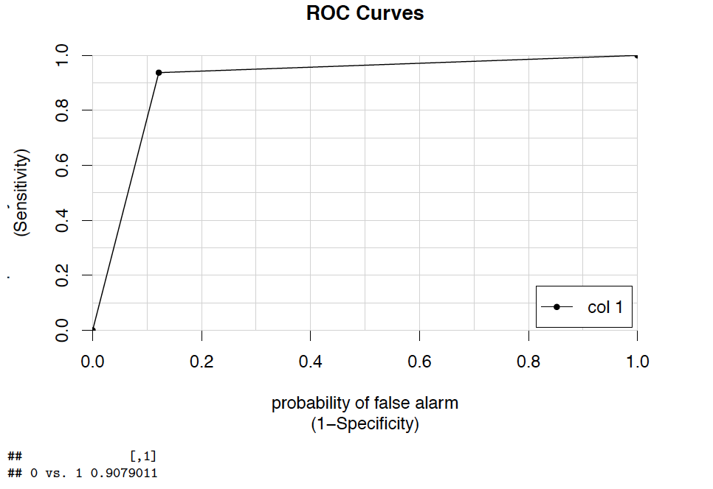
Comparison
Original training data set
Resampling training data set
AUC=0.8788102
AUC= 0.9079011

Slide 25
PART THREE
Conclusion & Discussion

Slide 26
Model Comparison

Slide 27
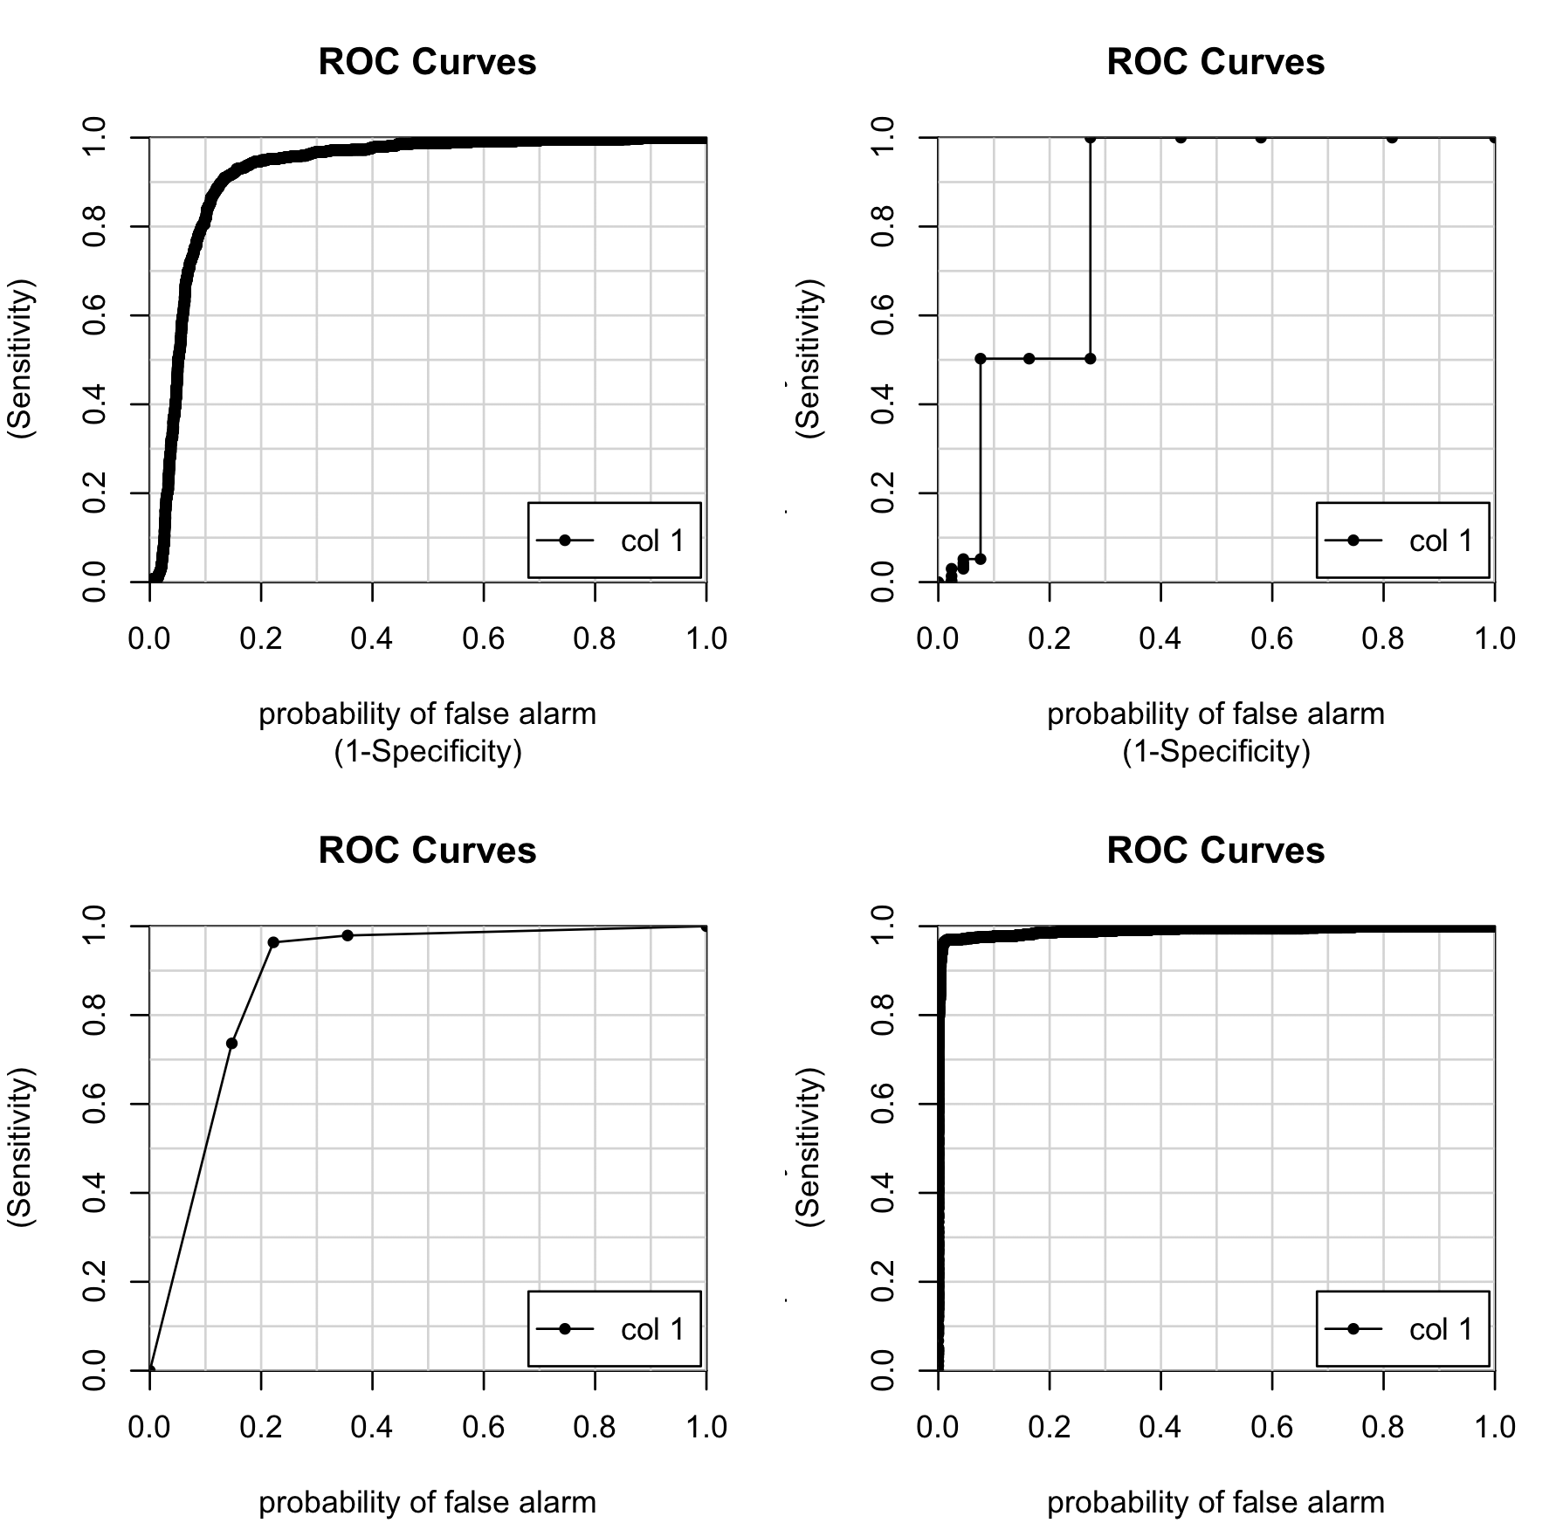
Comparison: ROC & AUC
Classifier | Logistic | Decision Tree | Random Forest
AUC | 0.91 | 0.89 | 0.96

Slide 28
Comparison of RF and Logistic
Logistic
Real/Predict | 0 | 1
0 | 2987 | 413
1 | 69 | 1031
Random Forest
Real/Predict | 0 | 1
0 | 3364 | 36
1 | 40 | 1060
classifier | precision | recall | Cost time
Random Forest | 0.96 | 0.96 | 1min5s
Logistic Regression | 0.72 | 0.94 | 1.13s
Sometimes there is some conflict between performance and explainability for algorithm, Random Forest has higher performance, but logistic regression is simpler and we can find the effect of specified variable to response variable easily

Slide 29
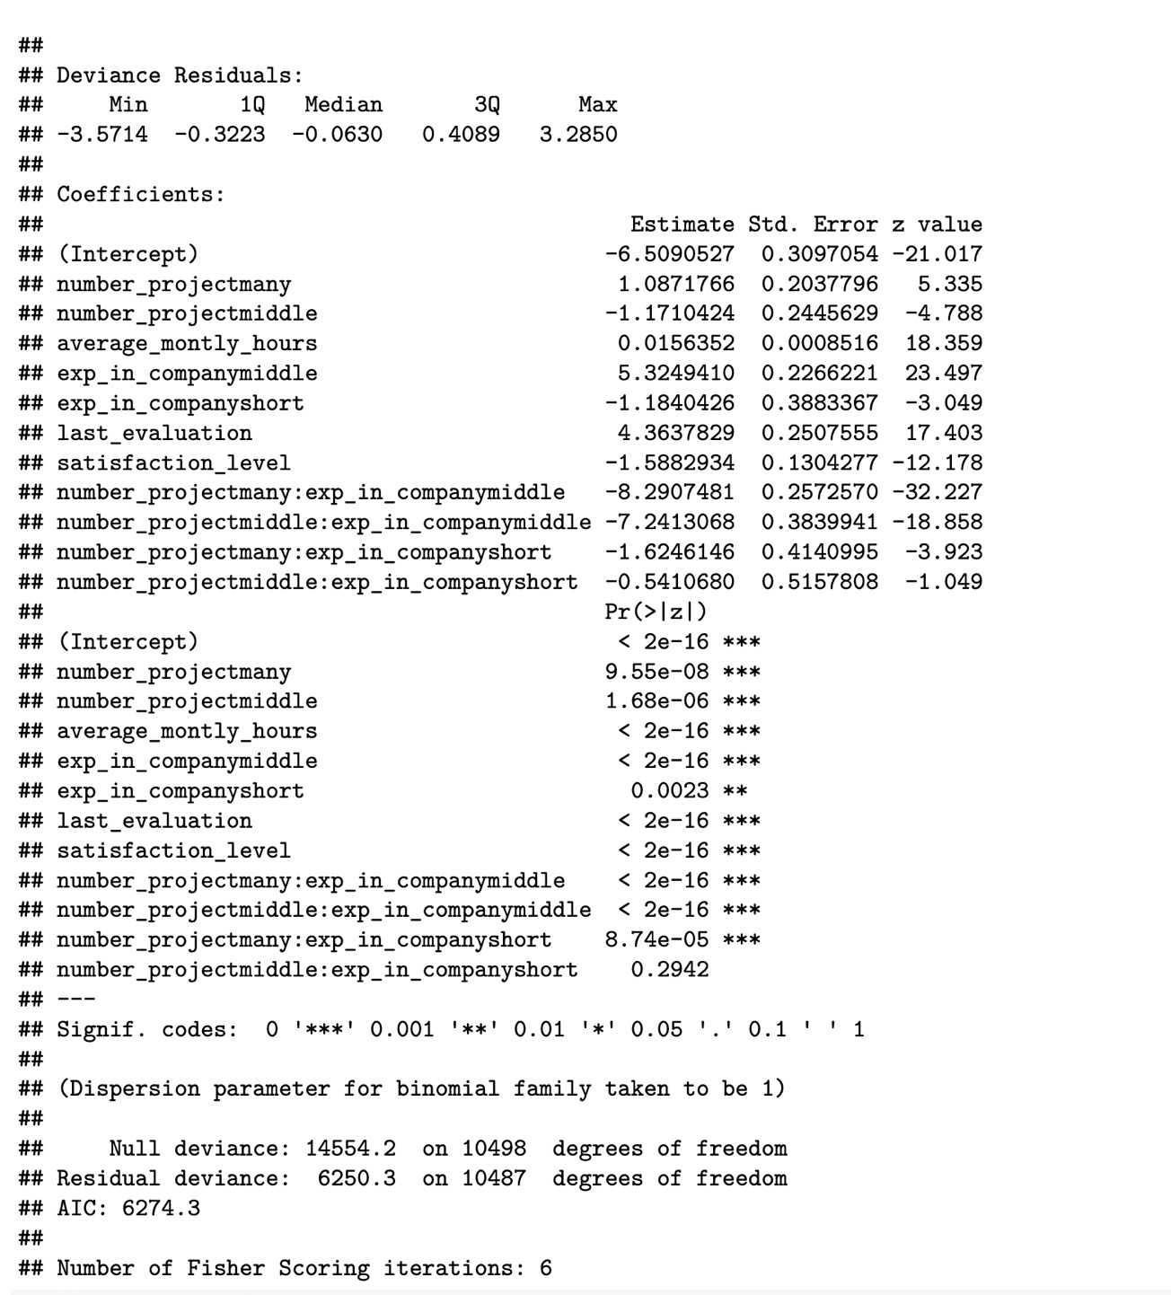
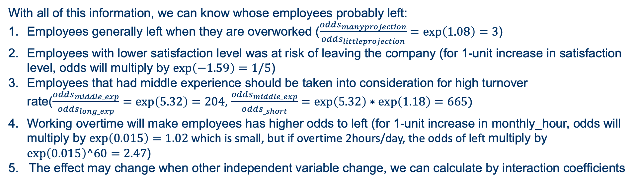
$$Logistic Model:logit\left(\hat{π}\right)=−6.51−1.59satisfaction_{level}+5.32experience_{middle}−1.18experience_{short}+…$$
With all of this information, we can know whose employees probably left:
Employees generally left when they are overworked ($\frac{odds_{manyprojection}}{odds_{littleprojection}}=\exp\left(1.08\right)=3$)
Employees with lower satisfaction level was at risk of leaving the company (for 1-unit increase in satisfaction level, odds will multiply by $\exp\left(−1.59\right)=1/5$)
Employees that had middle experience should be taken into consideration for high turnover rate($\frac{odds_{middle_exp}}{odds_{long_exp}}=\exp\left(5.32\right)=204,$ $\frac{odds_{middle_exp}}{odds_{_short}}=\exp\left(5.32\right)∗\exp\left(1.18\right)=665)$
Working overtime will make employees has higher odds to left (for 1-unit increase in monthly_hour, odds will multiply by $\exp\left(0.015\right)=1.02$ which is small, but if overtime 2hours/day, the odds of left multiply by $\exp\left(0.015\right)^60=2.47$)
5. The effect may change when other independent variable change, we can calculate by interaction coefficients

Slide 30
Discussion: Log-linear Model

Slide 31
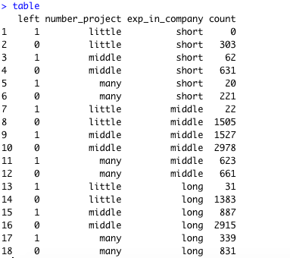
Contingency table with first 2 IV variables

Slide 32
Logliner model for exp_in_company(E), number_project(N) and left(L)
Model | G² | X² | df | P-value(for G²）
(E, N, L) | 2136.514 | 1723.679 | 12 | 0
(LN, E) | 510.3102 | 459.8981 | 10 | <0.001
(LE, N) | 1682.227 | 1235.203 | 10 | <0.001
(EN, L) | 2120.257 | 1713.508 | 8 | <0.001
(LN, LE) | 56.02369 | 55.93226 | 8 | 2.791036e-09
(EN, LN) | 494.0534 | 444.7718 | 6 | <0.001
(EN, LE) | 1665.970 | 1238.152 | 6 | <0.001
(EN, LN, LE) | 30.24496 | 30.08973 | 4 | 4.363369e-06
(LNE) | 0.0 | 0.0 | 0 | --

Slide 33
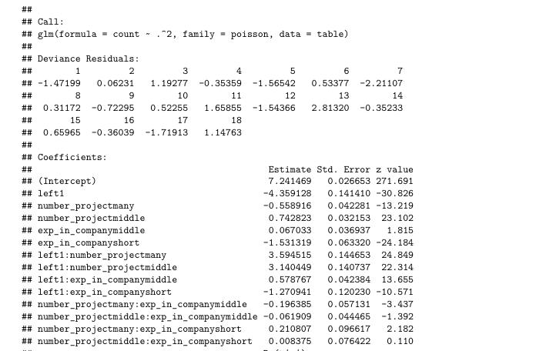
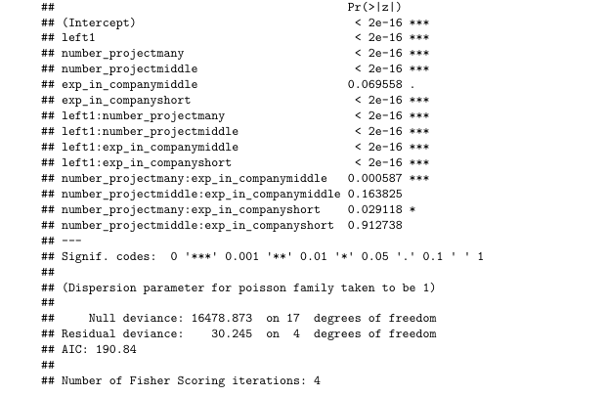
Logliner model for exp_in_company(E), number_project(N) and left(L)

Slide 34
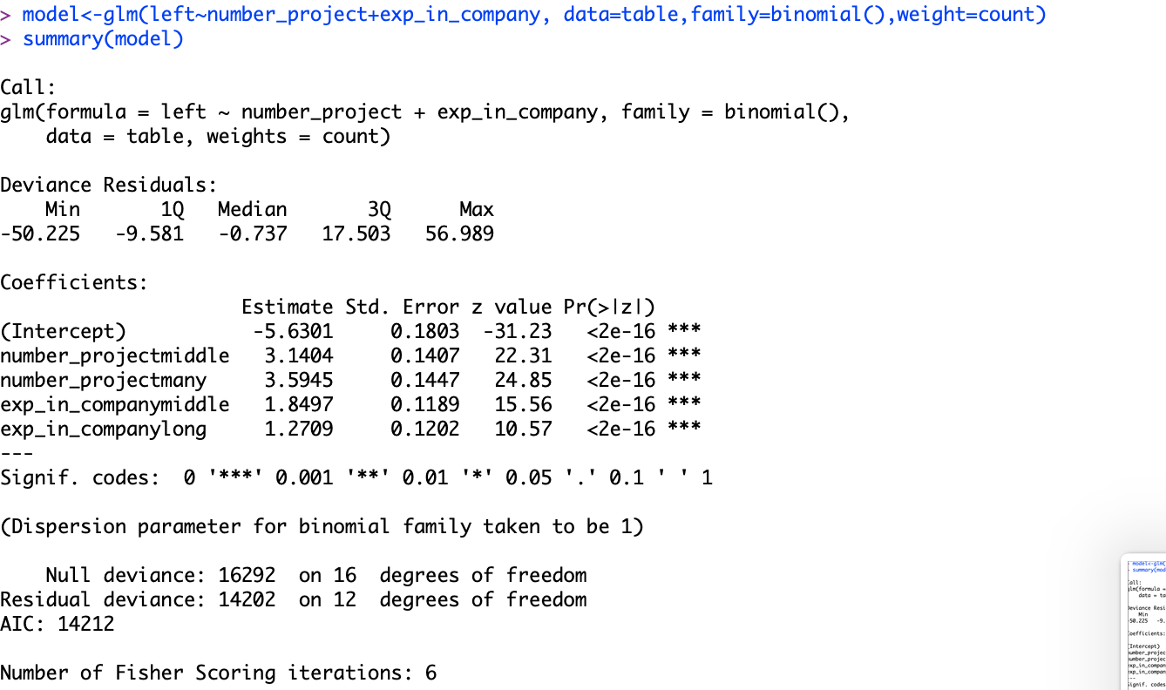
Logistic Regression model for exp_in_company(E), number_project(N) and left(L)

Slide 35
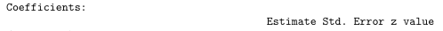
Summary of contingency table
Logliner：
Logistic：
The number of projection and experience in company has effect on left variable
Employees generally left when they are overworked
Employees that had middle experience should be taken into consideration for high turnover

Slide 36
Conclusion
With all of this information, we can know whose employees probably left:
Employees generally left when they are overworked
Employees with lower satisfaction level was at risk of leaving the company
Employees that had middle experience should be taken into consideration for high turnover rate
Working overtime will make employees has higher odds to left
5. The effect may change when other independent variable change, we can calculate by interaction coefficients

Slide 37
THANK YOU !

